Slide 1


Real Estate House Pricing
Data Visualization-Project-
Debasis Panda
GitHub Link-https://github.com/Deb052024/Data-Visualization.git

Slide 2

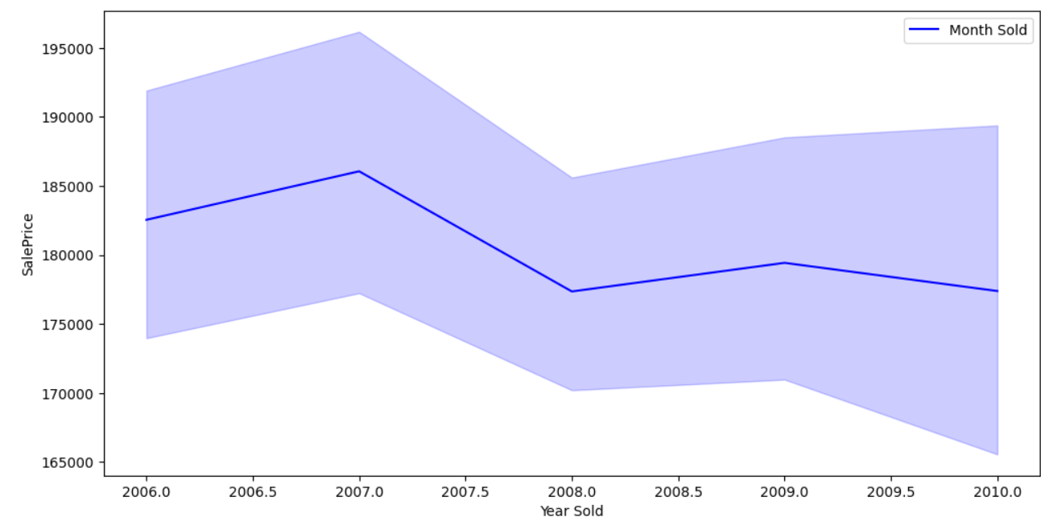
House Pricing Case Flow
Problem Statement and Situation Overview
Attribute Information and EDA
Feature Engineering and Size Impact
Market Trend and Historical Pricing
Customer Preference and Amenities
Univariate analysis
Multivariate Analysis
Important Findings and Conclusion

Slide 3
Problem Statement and Situation Overview
Problem Statement
In the dynamic landscape of the residential real estate market, determining an optimal and competitive price for a house is a multifaceted challenge. Here task is to conduct a comprehensive analysis to identify and understand the myriad variables that significantly influence house prices. By leveraging advanced data analytics techniques and visualization tools, goal is to uncover patterns, correlations, and trends within the dataset, enabling the company to make informed decisions and strategically position properties for better business opportunities.
Situation Overview
The real estate industry is inherently complex, influenced by numerous factors that collectively impact the pricing of residential properties. The task at hand is to navigate through this complexity and extract meaningful insights from the available data. Here the objective is to not only identify the key variables affecting house prices but also to provide actionable recommendations based on your findings.
The dataset comprises diverse parameters such as location, size, amenities, market trends, economic indicators, and historical transaction data. These variables contribute to the intricate web of pricing dynamics, and goal is to unravel their interdependencies through meticulous analysis.
The ultimate objective is to empower the real estate company with a deeper understanding of the market forces at play. Idea is these insights will guide the pricing strategy, facilitating better decision-making for property acquisition, sales, and negotiation.
Moreover, the case findings may uncover opportunities for optimizing property values, enhancing customer satisfaction, and gaining a competitive edge in a dynamic and ever-evolving real estate landscape.

Slide 4
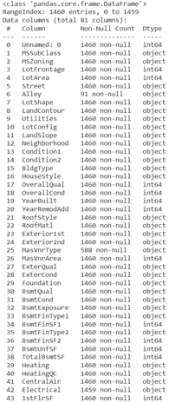

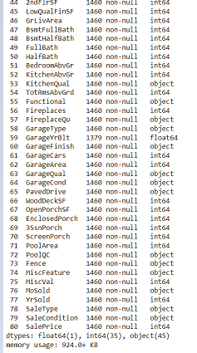




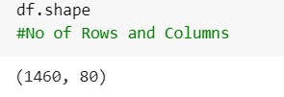
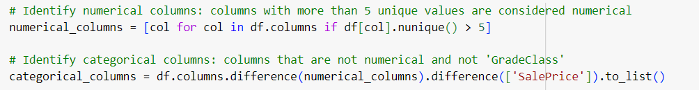
Attribute Information and EDA
EDA and Interpretation
Null Value Identification
Dropping Unnamed Column, Not required for analysis
Null Values have been Replaced
4 columns with null values identified
Alley feature with more than 90% null value, not healthy for analysis
Rest null values have been replaced during analysis
Data set has 1460 Rows and 80 columns
4 columns have got Null Values
Unnecessary column ”Unnamed “ has been dropped
45 Object, 35 Integer and 1 Float data Type in the data Set
Columns are separated between Categorical and Numerical
Columns with more than 5 unique value are categorized as Numerical
Sale Price has been included in the Numerical Column category

Slide 5
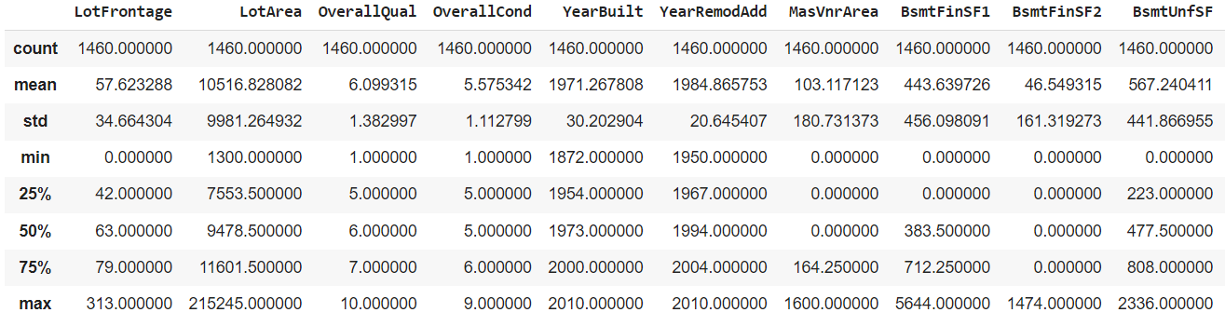
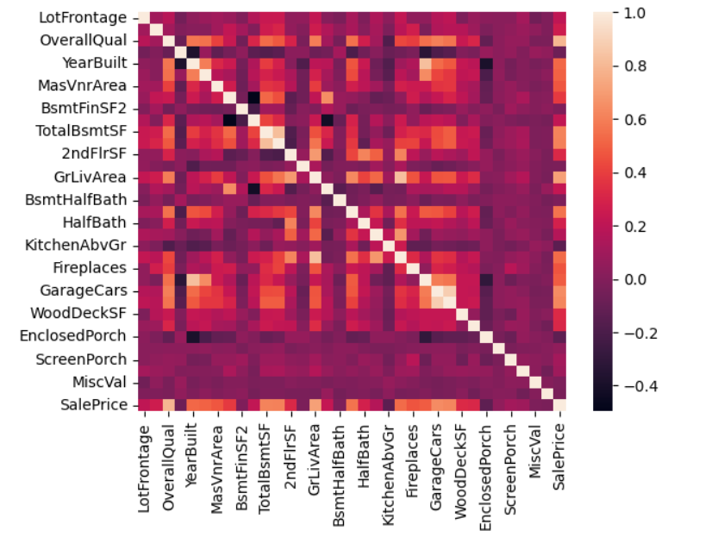
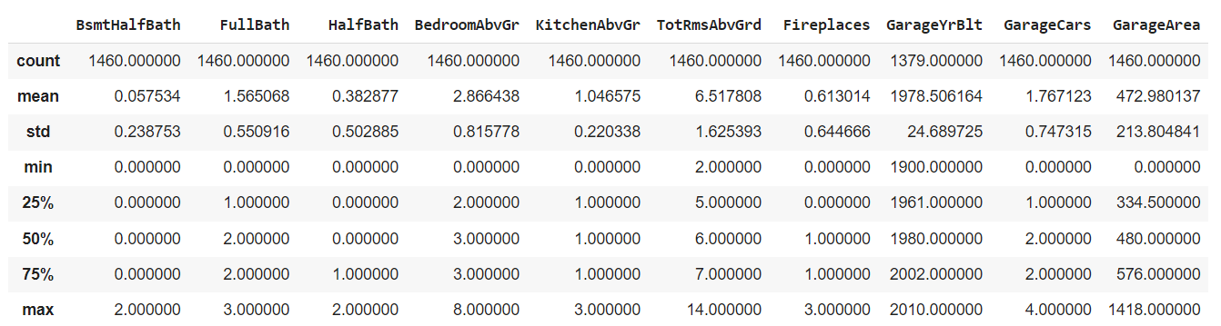
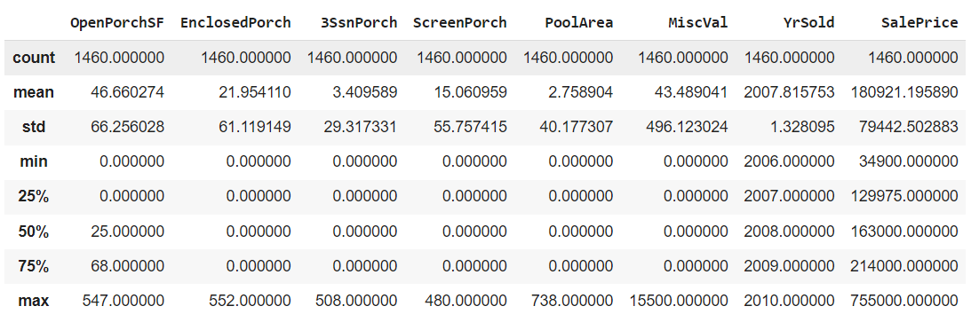
Interpretation on Numeric Feature and Correlation
Heat Map of Numeric Features of Data Set
EDA of the Features
1. Highest sale Price 7.5L
2. Maximum 4 garages
3. Average Overall Qual is 6
Analysis of Feature Description and Heat Map
1. LotFrontage, Ovear all Qual,Year Bulit, Masonry veneer area,Type2 Finished sqft,Second Floor Sqft, Above Ground Living area are having positive correlation with Sale Price

Slide 6
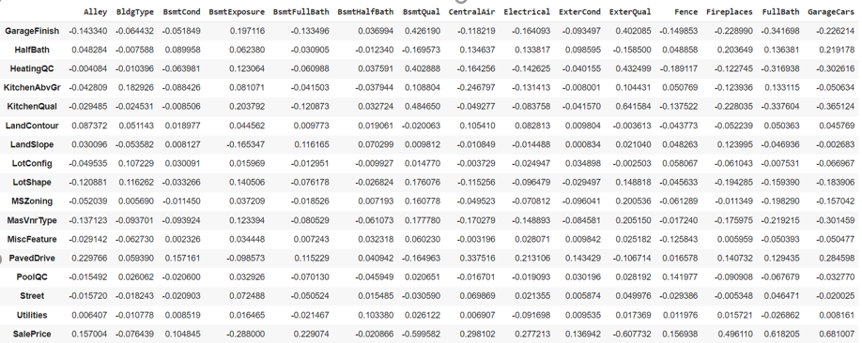
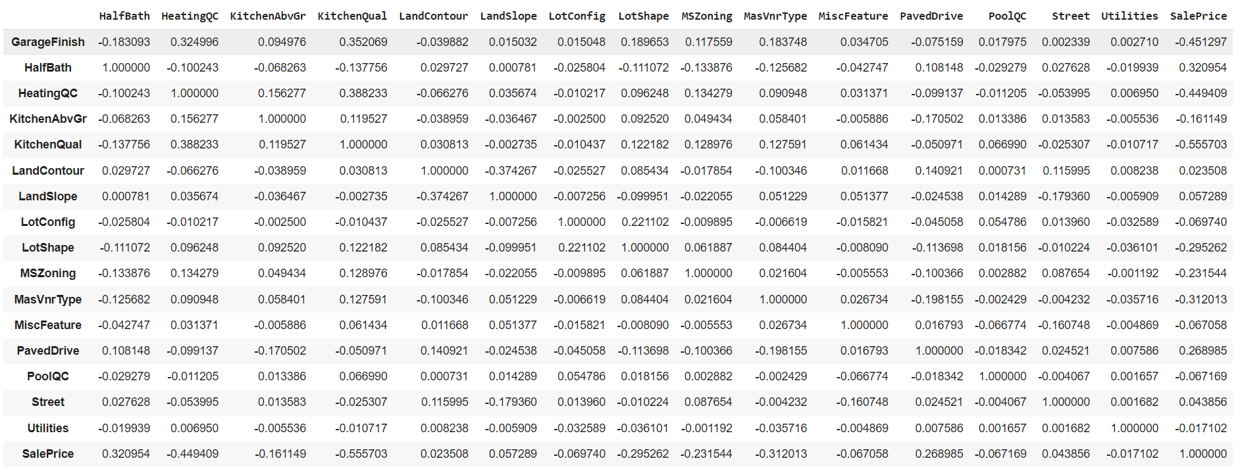
Interpretation on Categorical Feature and Correlation with Sale Price
Categorical Feature in a Data Frame , Label Encoding and Finding Correlation with SalePrice
categorical1_columns=df[['Alley','BldgType','BsmtCond','BsmtExposure','BsmtFullBath','BsmtHalfBath','BsmtQual','CentralAir','Electrical','ExterCond','ExterQual','Fence','Fireplaces','FullBath','GarageCars','GarageFinish','HalfBath','HeatingQC','KitchenAbvGr','KitchenQual','LandContour','LandSlope','LotConfig','LotShape','MSZoning','MasVnrType','MiscFeature','PavedDrive','PoolQC','Street','Utilities','SalePrice']]
from sklearn.preprocessing import LabelEncoder
le=LabelEncoder()
for column in categorical1_columns.columns:
categorical1_columns[column]=le.fit_transform(categorical1_columns[column])
Categorical variables were stored in a separate Variable and they were encoded using LabelEncoder including SalePrice
BsmtFullBath,CentralAir,FirePlaces,FullBath,GarageCars,HalfBath,PaveDrive are few key features with high positive correlation with SalePrice
Correlation has been shown using iLoc Function on two separate parts including all columns

Slide 7
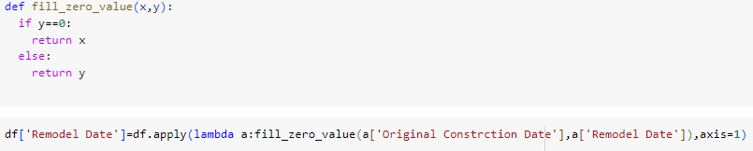
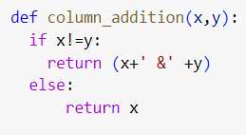
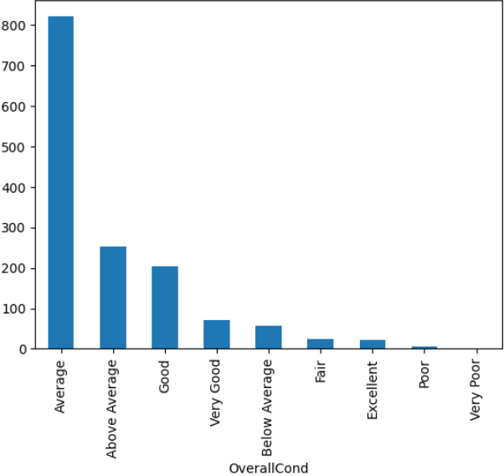
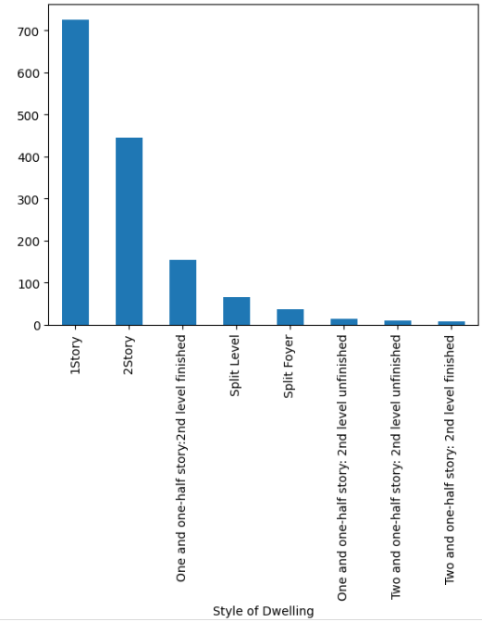
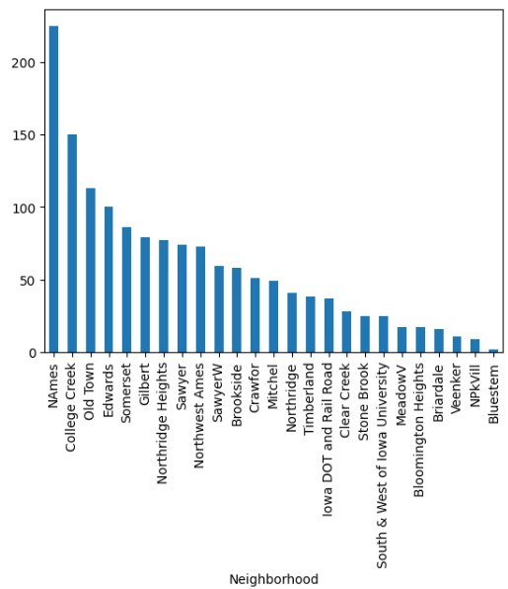
Feature Engineering and Size Impact
Feature Engineering
Columns along with its Features have been renamed as per the Data Dictionary
‘Rename’ and ‘replace’ have been used to do the updation with column name and its features
Based on Similar attributes for two columns(condition1 , condition2), user defined Column_addition function has been created and features have been kept on a single column condition1 , condition2 column has been dropped
Count Plot has been used to show the features post feature engineering
The OverallCond (Rates the overall condition of the house-highest no as average), style of Dwelling(Maximum as 1 story), Neighborhood(Maximum as Names-North Ames)
‘Original Construction Date’ and ‘ReModel Date’ column values have been checked and feature engineering used for filling null value in either of the columns

Slide 8
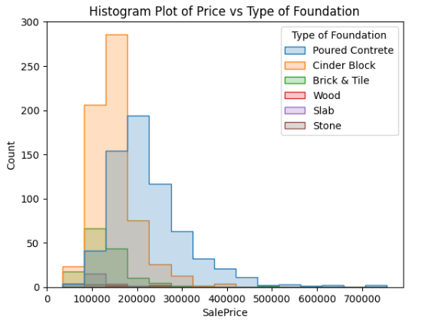
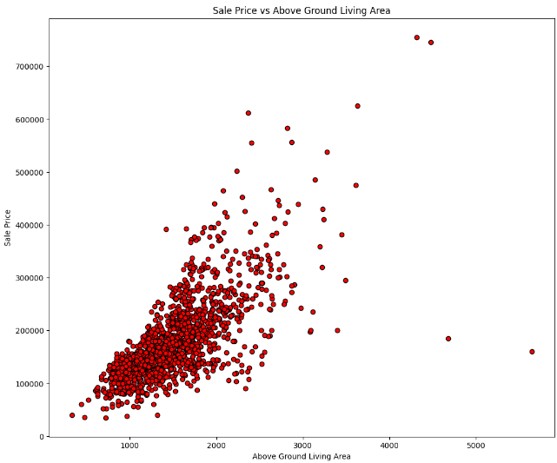
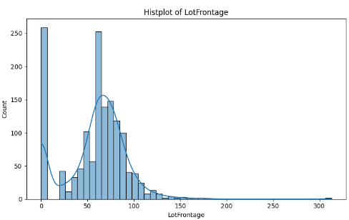
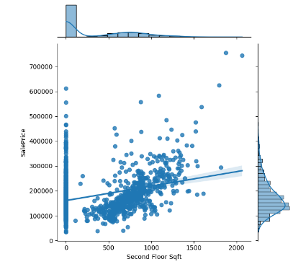
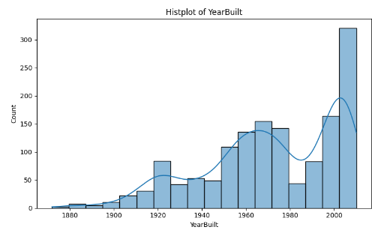
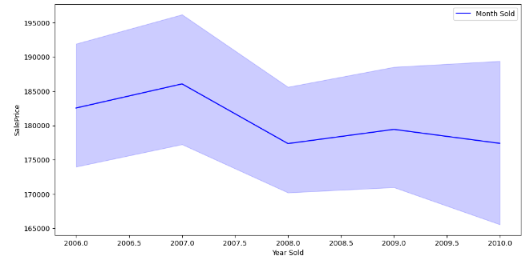
Market Trend and Historical Pricing
Histogram indicates Cinder Block Foundation followed by Poured Contrete , with highest and 2nd highest number, few Poured contrete have price beyond 7Lakh
Scatter Plot (Red one) indicates mostly above ground Living area ranges between 1000 to 2500 square feet
Second Floor Sqft has got a linear relation with the Sale Price
LotFrontage is missing in most case , followed by size between 30 to 150 sqft
Most of the Houses are built in the year 2000 and Beyond
Spike in House Price for years 2006 and 2009

Slide 9
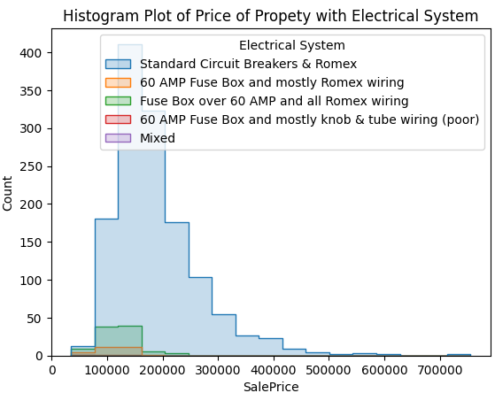
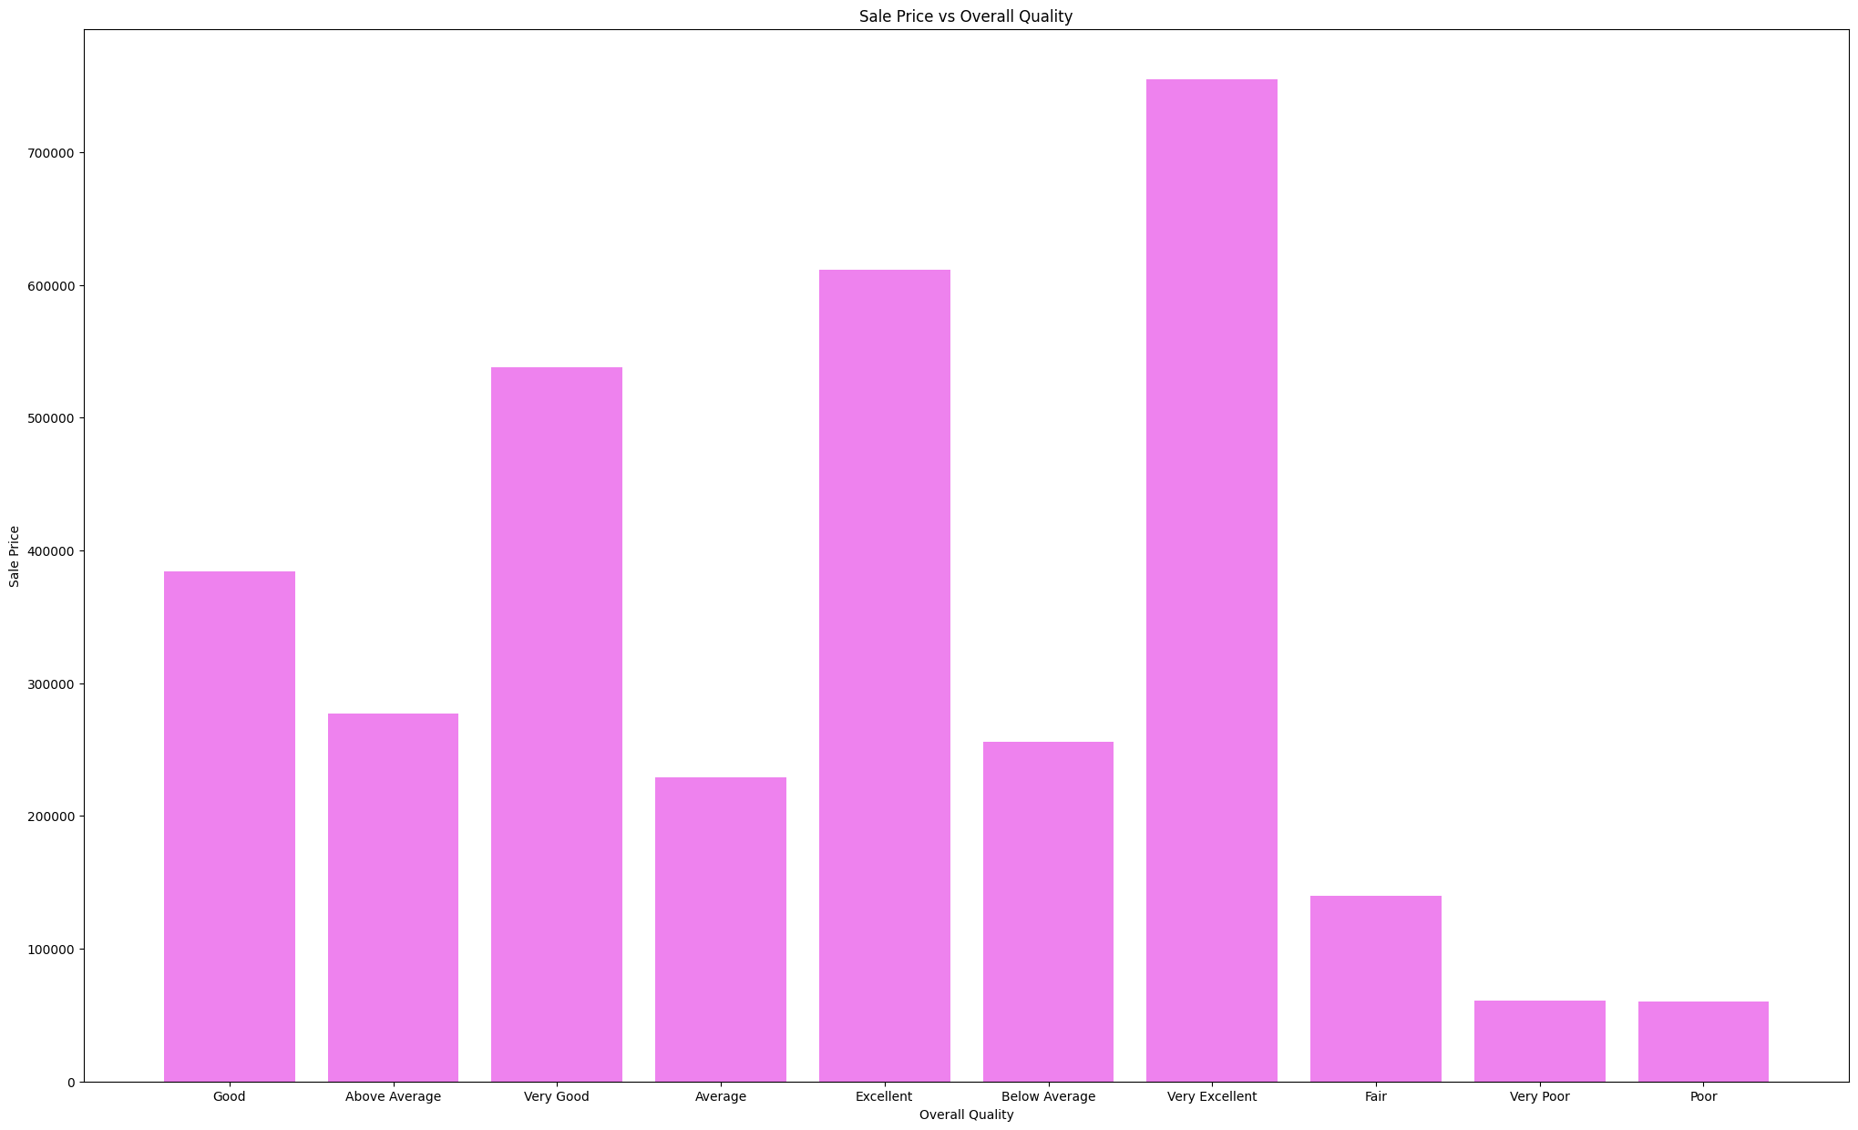
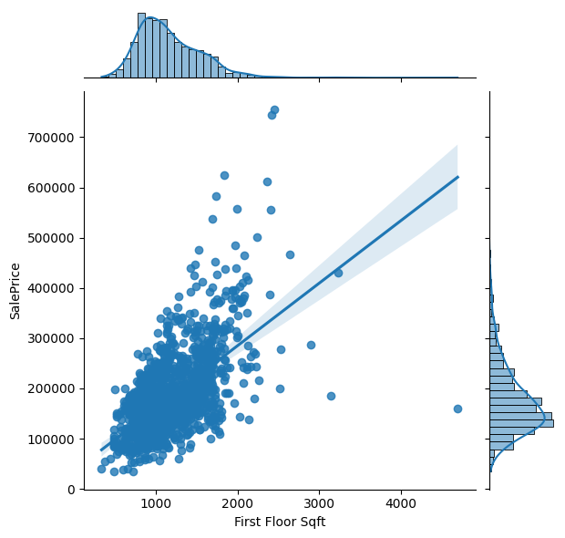
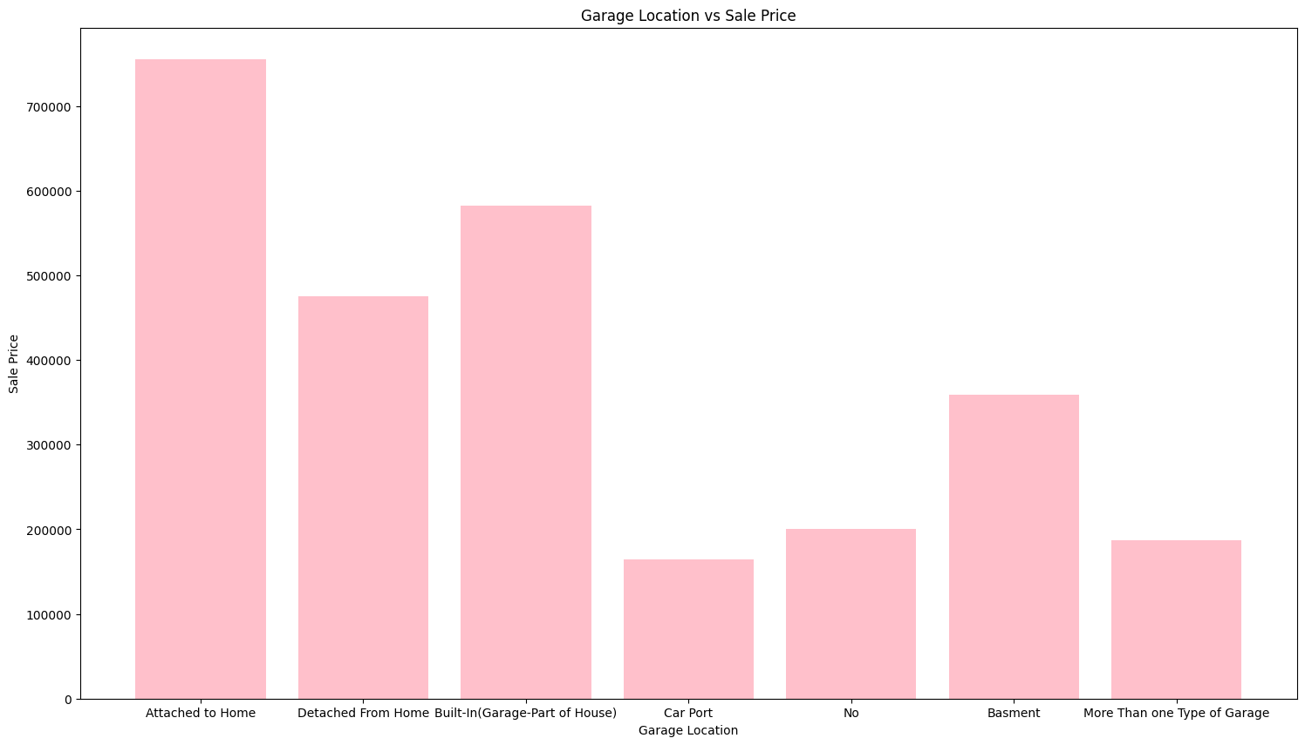
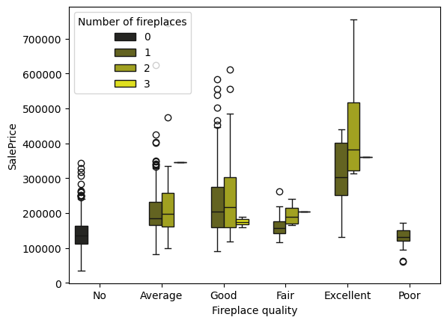
Customer Preference and Amenities
Interpretation of Electrical System and House Price
Standard Circuit Breakers with Highest Price and count ,along with the spread for the Houses
Houses with Fuse Box over 60 AMP and all Romex wiring are having the second hghest price
Interpretation between Overall Quality and SalePrice
Very Excellent -Overall Quality has got the highest Price, followed by excellent and very good
Garage Attached to Home has got the highest Pric, followed by Built-In Garage and Detached From Home
Basement Garage Price is placed in between No Garage and More than one Type of Garage
Car Port garage is having the least price
Interpretation of Box Plot with Fireplace Quality and No of FirePlaces
SalePrice of Excellent condition Fireplace quality homes with 2 no of fireplaces are the costliest
Maximum houses with Good condition Fire Quality are having 2 no of fire places and very few with 3 no of fire places

Slide 10
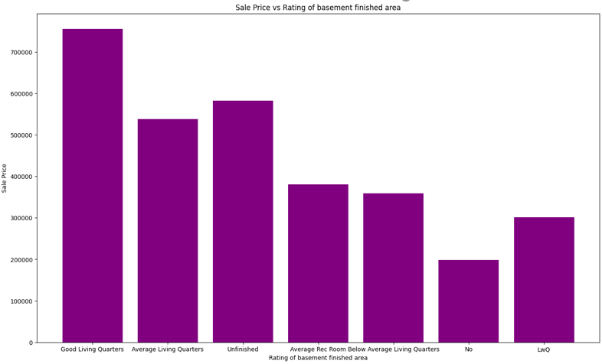
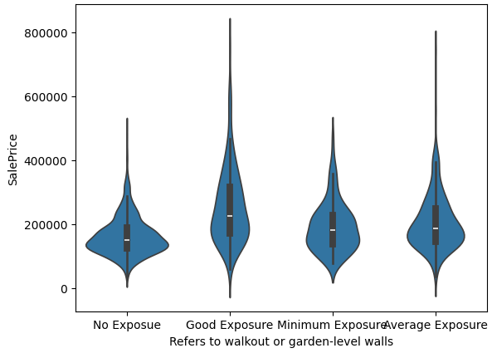
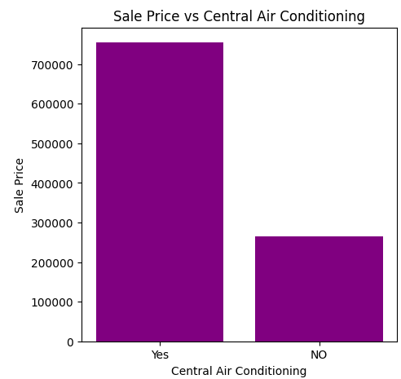
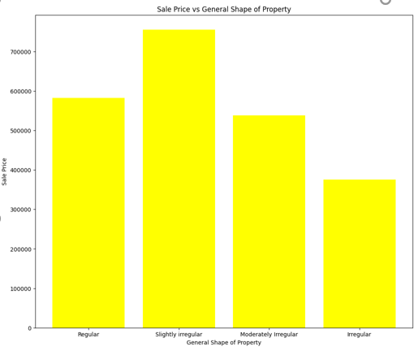
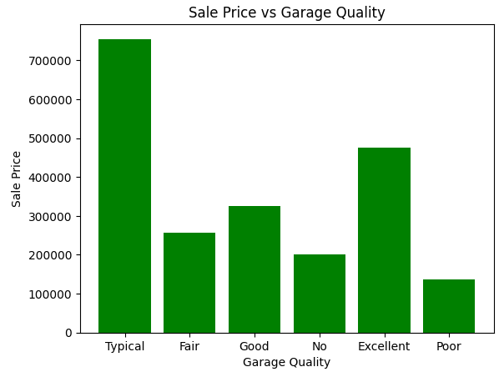
Univariate and Bivariate Analysis
Interpretation
Typical garage Quality with maximum Sale Price
Slightly Irregular Shape of Property with highest Sale Price
Houses with Air Conditioning with more price
Customers Prefer “Good Exposure” garden level walks
Good Living Quarters and unfinished are the ones with highest and 2nd highest prices

Slide 11
Multivariate Analysis
Interpretation Garage Quality VS House Price
1.Excellent Heating Quality and conditions have got the highest price
2."Gas Forced warm air Furnace " kind of heating with excellent Heating quality and Conditions have got the highest price
3.Fair condition Heating condition and Poor conditions are the 2nd least and least Sale Price house holds
Heating Quality and Condition VS House Price
1.Excellent Heating Quality and conditions have got the highest price
2."Gas Forced warm air Furnace " kind of heating with excellent Heating quality and Conditions have got the highest price
3.Fair condition Heating condition and Poor conditions are the 2nd least and least Sale Price house holds
Kitchen Quality and House Price
1.Houses with Excellent Quality Kitchen are the ones with highest price
2.Good Quality Kitchens are the ones with 2nd highest price

Slide 12
Important Finding and Conclusion
LotFrontage (Linear feet of street connected to the property), Ovear all Qual,Year Bulit, Masonry veneer area,Type2 Finished sqft,Second Floor Sqft, Above Ground Living area are having positive correlation with Sale Price
BsmtFullBath,CentralAir,FirePlaces,FullBath,GarageCars,HalfBath,PaveDrive are few key features with high positive correlation with SalePrice
Customer prefer houses with maximum 2 no of Fireplaces, air conditioning
There exists a strong positive trend between second Floor sqft and the price , so second floor planning need to be implemented accordingly.
Good Exposure garden area is a demand from the customers
Full Bath spaces are having high degree of preference by the customers and its impacting sales Price, they are preferred over Half Bath spaces
PavedDrive way is the choice that customers are looing for , it should be incorporated on the design and implementation part
2006-2007 and 2008-2009 years homes have shown an upward swing on the sale Price , mostly
Houses built on the year 1991 and 2005 have got the highest and 2nd highest overall quality feed back from the customers , the houses features, properties can be replicated for subsequent years for construction
Fair height of basement that is (70-79) inches are the most preferred among the customers

